Slide 1
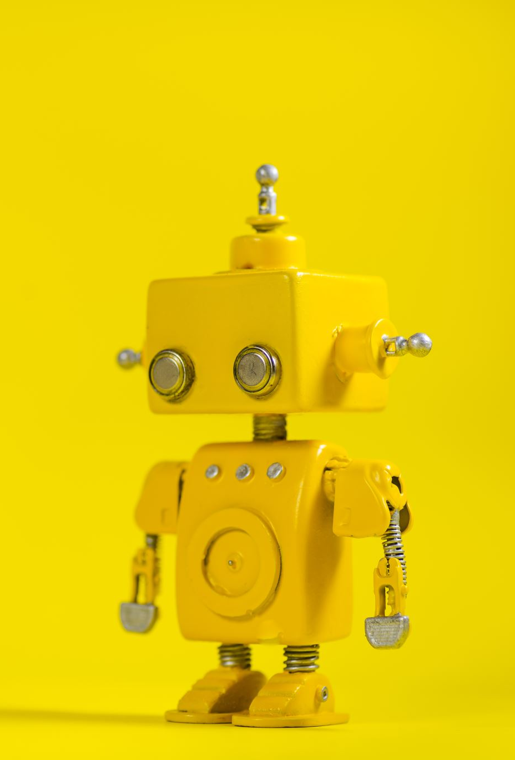
Predicting Machine Learning and Artificial Intelligence Subreddits
Anthony Reid
May 3, 2021

Slide 2
Table of Content
Problem statement
Background
Method/Findings
Performance
Conclusion

Slide 3
Problem statement
Background
Method/Findings
Performance
Conclusion
How can natural language processing algorithms be used to predict the difference between machine learning and artificial intelligence subreddit comments?

Slide 4
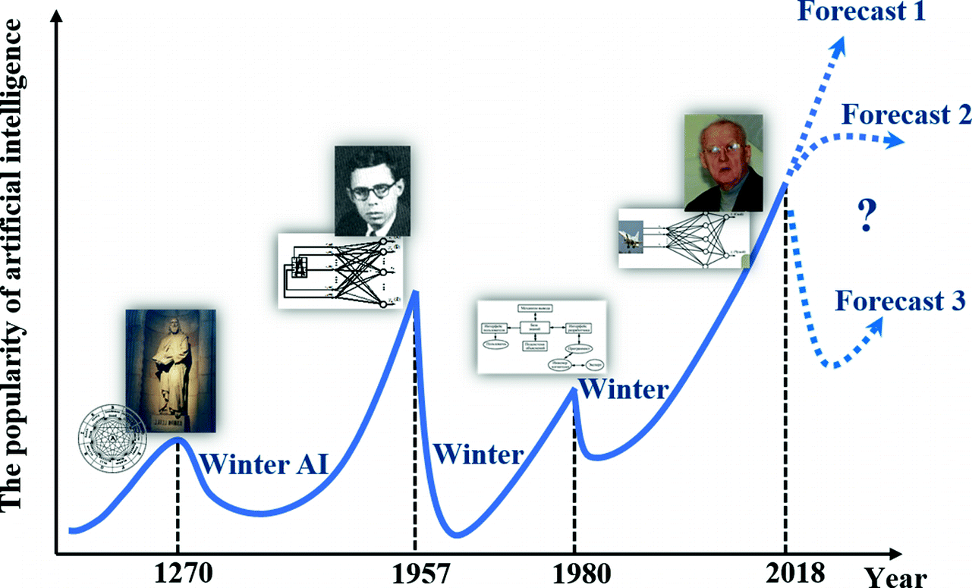
Problem statement
Background
Method/Findings
Performance
Conclusion
Artificial Intelligence
Machine Learning
https://link.springer.com/chapter/10.1007/978-3-030-22493-6_2

Slide 5
Problem statement
Background
Method/Findings
Performance
Conclusion
Artificial Intelligence
Machine Learning
https://link.springer.com/chapter/10.1007/978-3-030-22493-6_2

Slide 6
Problem statement
Background
Method/Findings
Performance
Conclusion
Evaluate:
Ensemble
Perform Analysis
Acquire Data
Clean and Process
Train model
Predict new data
Evaluate Accuracy
Compare to other models
Logistic Regression
ML Subreddit
Combined Data
Random Forest
AI Subreddit
Naïve Bayes

Slide 7
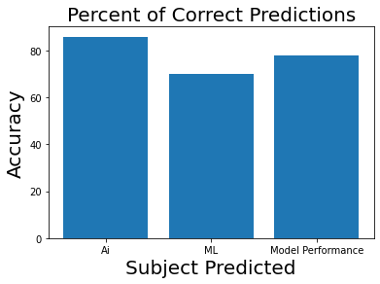
Problem statement
Background
Method/Findings
Performance
Conclusion
Highly Correlated ML words
Title
Criteria
ml
phd
Highly Correlated Ai words
robots
Start
source
humans
86 %
78 %
70 %

Slide 8
Problem statement
Background
Method/Findings
Performance
Conclusion
 | Text | Prediction
Definition of Ai | the use and development of computer … draw inferences from patterns in data. | Ai
Definition of ML | 'the theory and development of computer ... translation between languages.' | Ai
Correlated to ML | title criteria phd true | ML
Correlated to Ai | robots start liked source humans | Ai
Hacking | ml ml ml ml | ML
Hacking | ai ai ai ai | Ai
Out of context | Please predict machine learning | Ai

Slide 9
Problem statement
Background
Method/Findings
Performance
Conclusion
The model performs well with reddit texts but not out of context messages or hacking
More training data is always helpful, include titles or text from different sites and articles.

